Slide 1
Vending Machine Hardware Design
A Strawman plan

Slide 2
Assumptions
We want to pretend small company.
We want to minimize the NRE, Non Recurring Costs
We need to develop systems that can be reused in other projects and have a few years of life span.
We need to get the system out as fast as possible.
Since this is a prototype, we can push technology:
If it fails, we will not do it in the future
If it succeeds then we will have a valuable tool.

Slide 3
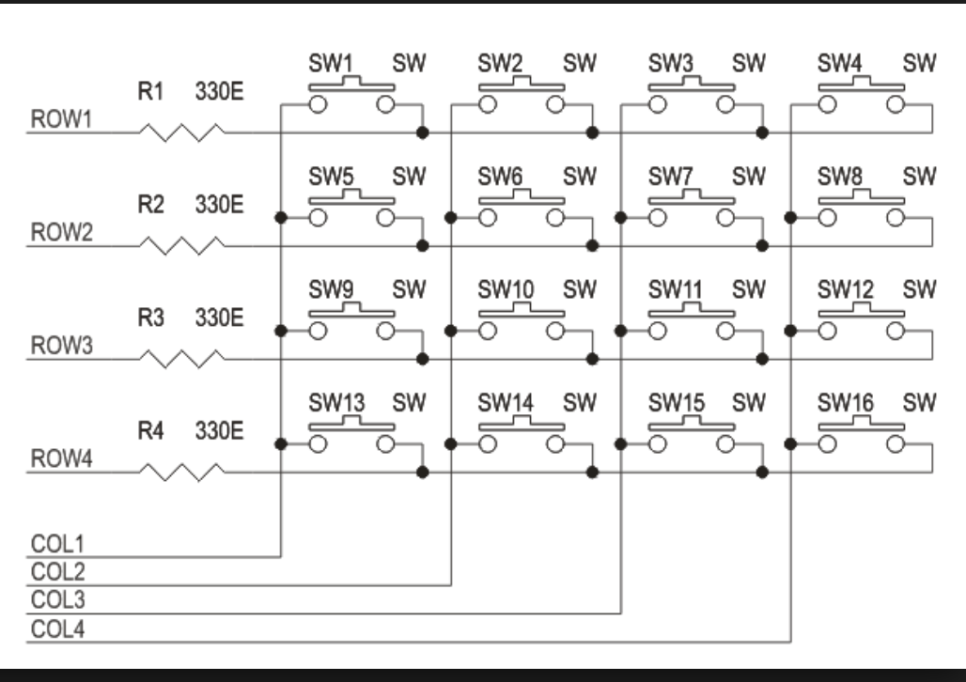
What I believe the motor arrangement is similar to a matrix key board as shown below

Slide 4
The difference is
The switches are replaced by motors
The rows are high side ( + voltage ) switches which turn on only one row.
The columns are low side (-voltage ) switches which turn on only one column.
This allows only one motor to turn

Slide 5
To synchronize the motion of the vending action
There is a third pin which appears to pull down for a period of time during the rotation. This is used to synchronize the vending machine operation.
Power
Resistor
comparator
Motor 1
Motor 2
Motor …
Motor N
Microprocessor

Slide 6
Cable harness and low side switches
For small to medium volumes the fabrication of cable harnesses can be labor intensive to build as well as test.
Low side switches are very cheap, particularly if motor current is .5 amps or below.
The UNL2303B from TI store in 1’s is $.89
A Lady Ada favorite part.
My approach is to remove the need for custom cable harnesses

Slide 7
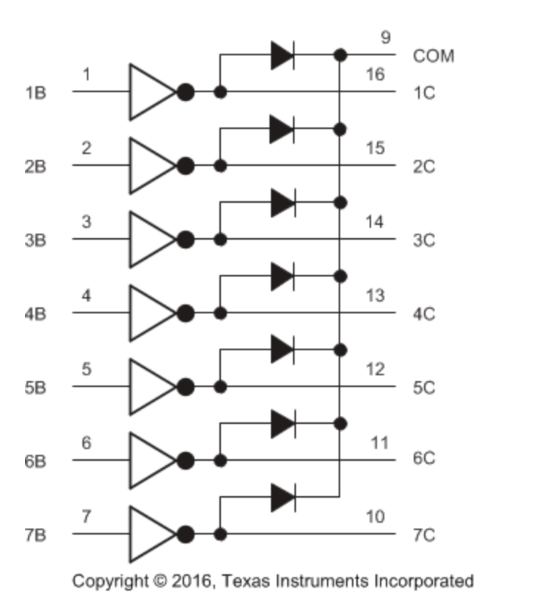
ULN2003B Layout Notice the fly back diodes for inductive loads

Slide 8
Vending Machine System
Raspberry Pi
Site Controller
WIFI Communication
Vending
Machine
Controller
BLE Communication
Slave for Row 1
Slave for
Row 2
Slave for
Row n
Slave for intrusion detection and
To detect product pickup

Slide 9
Two Type of Cables
There are two types of cables.
3 wire cables which connect the vending machine controller to the slave nodes
Wires
Hi for motor +24 Volts
Hi for slave +24 Volts
Common Low
Separate Hi for motor allows the slave to function if motor shorts
3 wire cable from slave unit to each motor.
Hi for Motor +24 Volts
Low for Motor
Line for synchronization ( 3.3 V ???)

Slide 10
What Bluetooth over RS485
BLE was chosen to be communication mechanism within the case because a BLE processor would be as cheap as a processor with a high grade industrial RS485 transceiver.
With the addition of upcoming BLE mesh, the BLE solution may be more attractive.

Slide 11
Vending Machine Controller
Vending Machine Controller Hardware
High Side Motor Drive
WIFI Commands
24 Volt
To 3.3 Volt Switching
Regulator
ESP32
Processor
High End Driver
PWM Bridge
Current
Sense
Resistors
Measure
Vending
Machine
Motor
Current
Motor Return Current
BLE Command To Slave

Slide 12
Motor Slave
Pins to identify Vending Machine Row
Slave would have one command. Spin motor one cycle
Slave Unit
BLE Commands
From Controller
BLE Processor
ESP32 ??
24 to
3.3
Switching
Regulator
Sense line from
motors
Comparator
Darlington Pair Low
Drivers
To motors

Slide 13
Hardware
Hardware Design consists of assembling modules
ESP32
24V – 3.3 DC switching regulator
Bridge Module
ULN23003B are in dips and easy to make modules
Main Cost of Hardware will be in plastic enclosures

Slide 14
Vending Machine Controller Software
Redis Db
Alert
Logs
Status
Information
Current
Logs
RPC
Server
Job Stream
Graph
DB
Monitoring
System
Vending A Product
Initialization
ESP32 Processes
Slave Modules

Slide 15
Vending Machine Software Steps
Initial Operations
Open Connection to Redis Data Base and Access Graph Database
Identify Slaves
Verify Connections with Slaves
Open up RPC server to accept commands from Raspberry PI
Power High Side Motors off
Steady State Operation
Verify Operation of Slaves
Verify Product Bin is Closed – Report incidents

Slide 16
Vending Machine Controller
Vend product request for RPC queue
Issue endowment to start vend to pi side
Identify Correct slave.
Turn on High Side Current
Start Current Monitoring and Recording
Tell slave to start motor cycle
Stop if excessive current is received and report back to pi
Wait for complete from slave.
Turn off high side power and close current monitoring
Wait for customer to pick up product.
Assemble vend package and send it to the redis data base.
Report Exceptions to the vend transaction

Slide 17
PI Site Controller
Pi Site Controller will have two functions.
Control and Monitoring of Vending Machine
Customer Transaction and the Management of Mark Coin ( Digital Money)
This presentation will address the 1st topic only.
The PI Site Controller consist of two activities
Monitor Vending Machines that are on the site.
Manage the vend request from the financial side of the server.
Support Service Requests from
Offsite Cloud Monitors
Factory Fabrication
Service Technicians
Service Workers Filling the vending Machine
4 levels of users

Slide 18
QPR Code
The vending machine will have a QPR sticker that will send the user to the Mark Coin web site to select and pay for the product

